Slide 1
Image recognition
Part 1: Decomposing a task

Slide 2
Learning outcomes
know that complex tasks can be broken down into smaller steps, and that this process is called decomposition.
know that an algorithm is a set of steps for solving a problem.
know that information in computers is stored in variables.

Slide 3
Key words
variable
A place for storing data.
In a computer, this is a section of memory.
In maths, a variable is a symbol that takes the place of numbers. For example: in x + 2 = 5, x is a variable.
value
In computing, this is the information in a variable.

Slide 4





Key words
An algorithm for solving the problem of not having any tea
Step 1 Boil some water | Step 2 Pour boiled water in a cup
Step 3 Put a teabag in the cup of hot water | Step 4 Let the teabag steep.
Problem solved Now you have a cup of tea!
algorithm
A set of instructions for solving a problem.
This word is also used in maths with the same meaning.

Slide 5

Key words
decompose
To break down into smaller or simpler parts.
Example
This castle can be decomposed into simple wooden blocks.

Slide 6
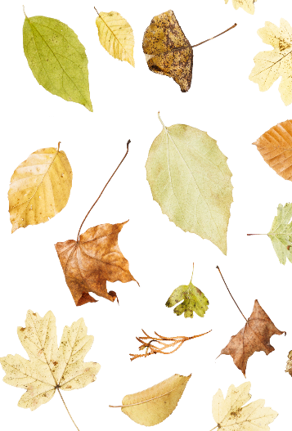
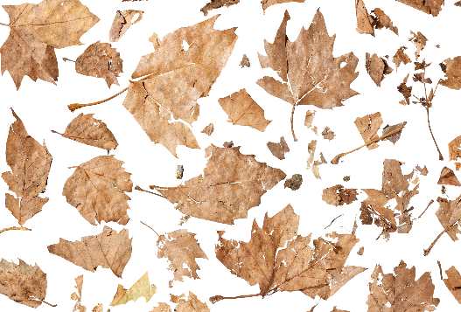

Key words
1
Leaves decomposing
Decompose is also used in science (biology) where it refers to the process of rotting.
Rotting, or biological decomposition, is the process of once living things being broken down into smaller parts or simpler chemicals, usually by being eaten by fungi, insects, or other organisms.
Living things can then absorb these parts or chemicals as nutrients and use them to grow.
2
3

Slide 7
Can computers help identify different types of bumblebee?

Slide 8

Computers, including AI tools, can only follow instructions they are programmed with.
A set of instructions for solving a problem is called an algorithm.
A computer programme is a set of algorithms written in a language that the computer can understand.
A JavaScript coding window

Slide 9
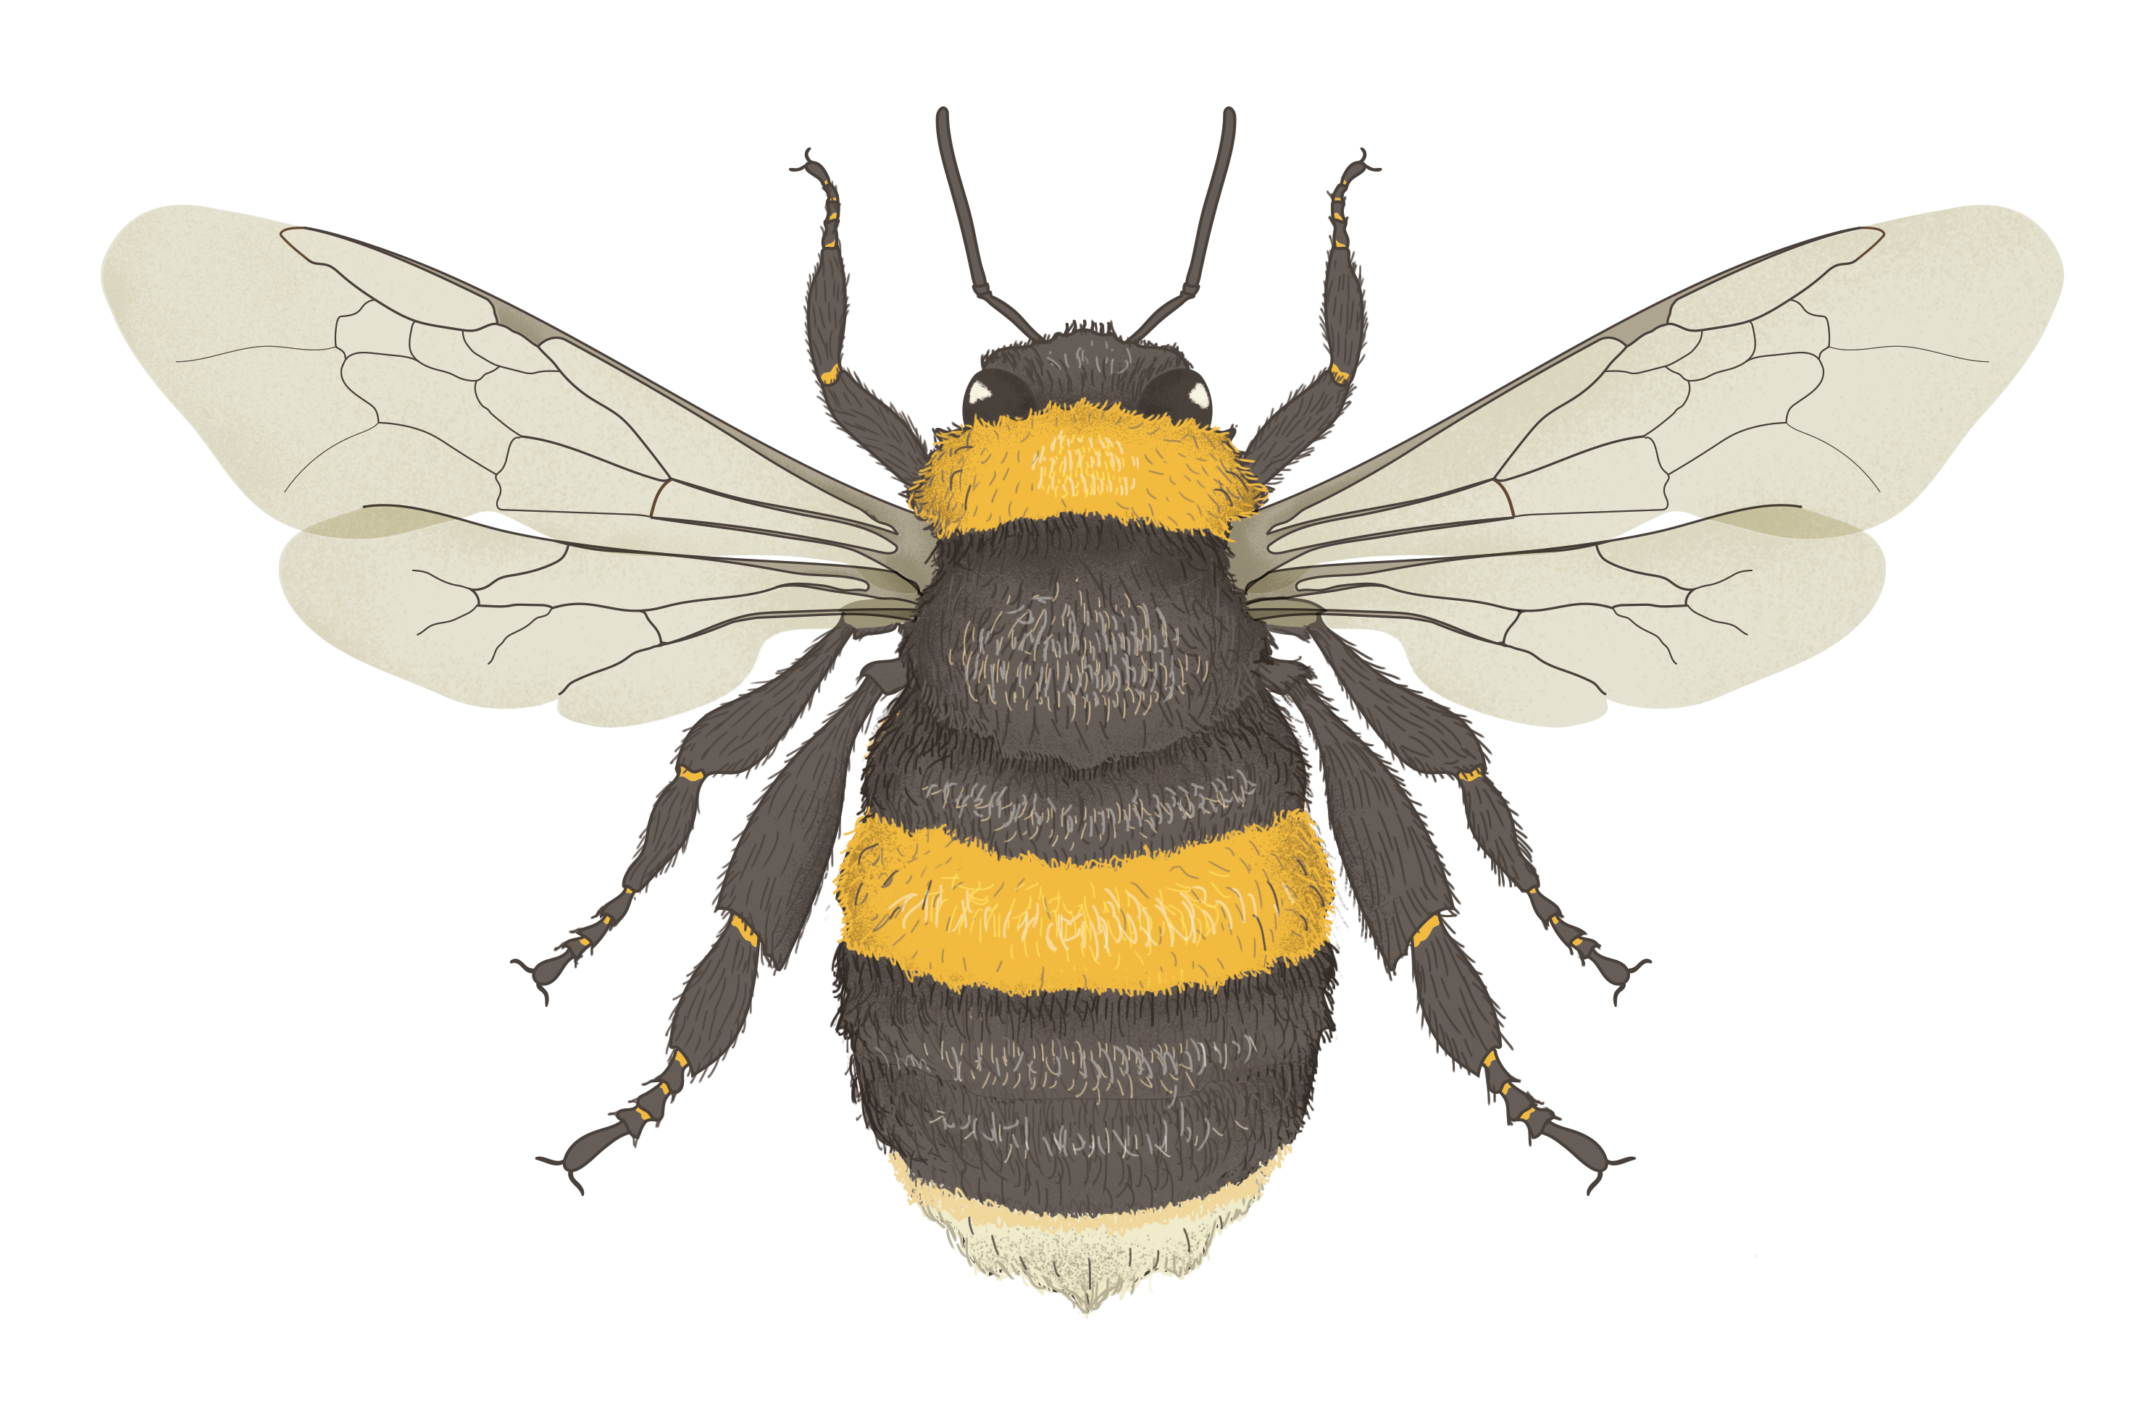
A simple bumblebee identification algorithm
Forewings
Bumblebees are:
Insects
  6 legs, 3 main body parts
Related to wasps and other bees
  2 pairs of wings
Fuzzy
Head
Thorax
Abdomen
Hindwings

Slide 10
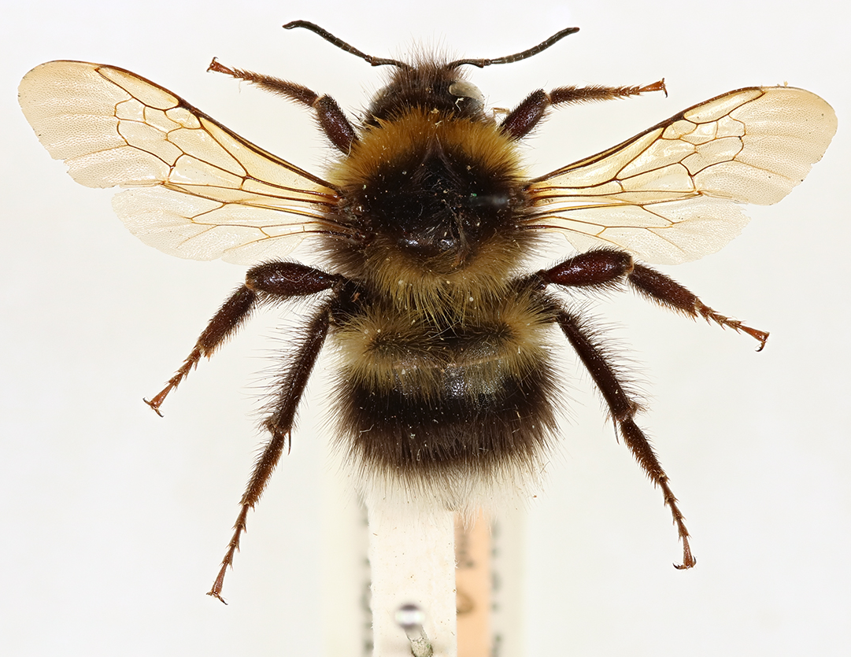
Here is a specimen from the Natural History Museum. Is it a bumblebee?
Does it have:
  6 legs, 3 main body parts
  2 pairs of wings
  Fuzzy body
Notes:
This bumblebee is a specimen from the collections at the Natural History Museum. Scientists have been learning from this bumblebee for more than 50 years!

Slide 11
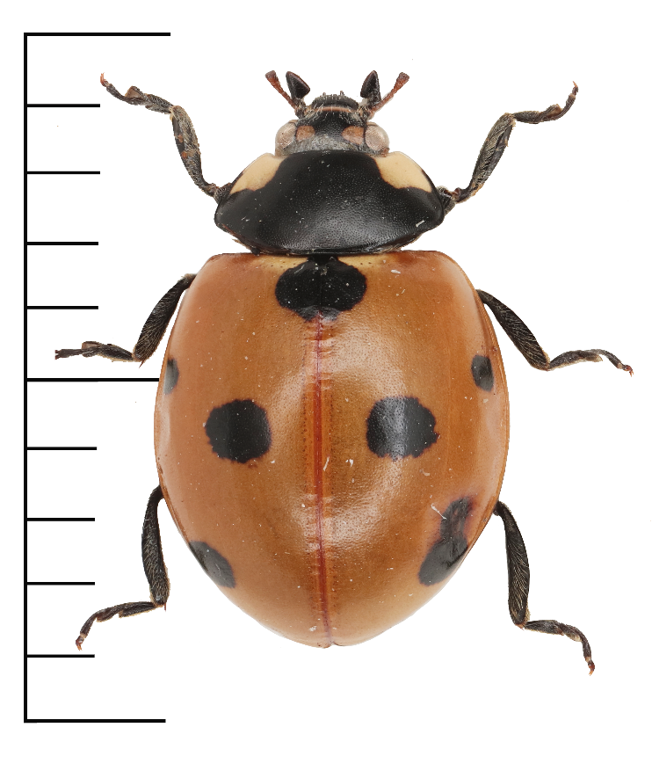
Here is a specimen from the Natural History Museum. Is it a bumblebee?
Does it have:
  6 legs, 3 main body parts
  2 pairs of wings
  fuzzy body

Slide 12
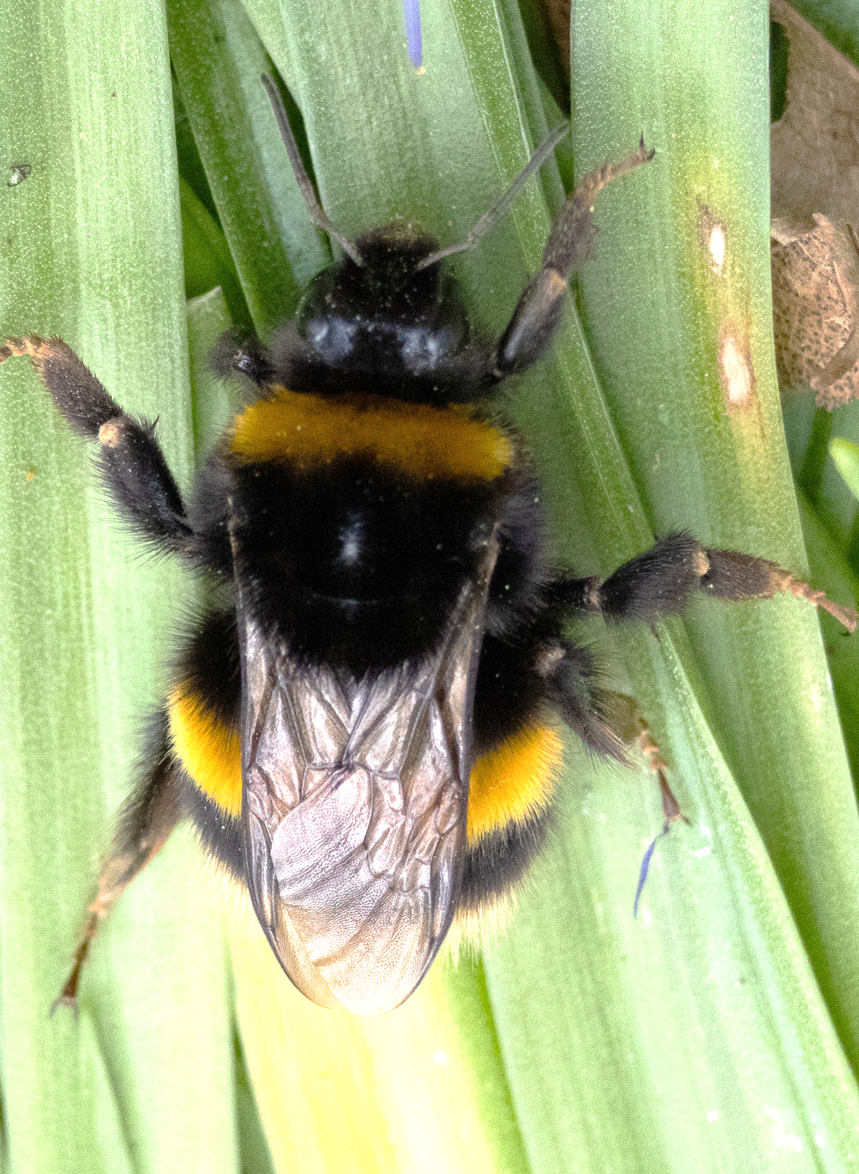
Here is a photo of an animal.
Is it a bumblebee?
Does it have:
  6 legs, 3 main body parts
  2 pairs of wings
  fuzzy body
iNaturalist observation 212382741. CC0

Slide 13
Not all the features are visible, but humans can still tell this is a bumblebee
Humans can be flexible and imaginative so we can understand that:
the bumblebee is resting with its wings folded back
it is hard to see all 6 legs because they are in different positions
iNaturalist observation 212382741. CC0

Slide 14
Extension
Why might a computer not be able to identify this as a bumblebee with the algorithm we have been using?
The algorithm we were using would not let a computer identify this animal as a bumblebee.
Not all the features used in the algorithm are easily visible.
iNaturalist observation 212382741. CC0
Notes:
Humans can be flexible and imaginative. Without any instructions, we can imagine different ways to try to do something.
Computers can only follow the instructions they are programmed with. A set of instructions for solving a problem or doing a task is called an algorithm. A computer program is a set of algorithms written in a language that a computer can understand.

Slide 15
We’ve used a simple algorithm to identify if something is a bumblebee.
Now we need to make an algorithm to identify different types of bumblebees.

Slide 16
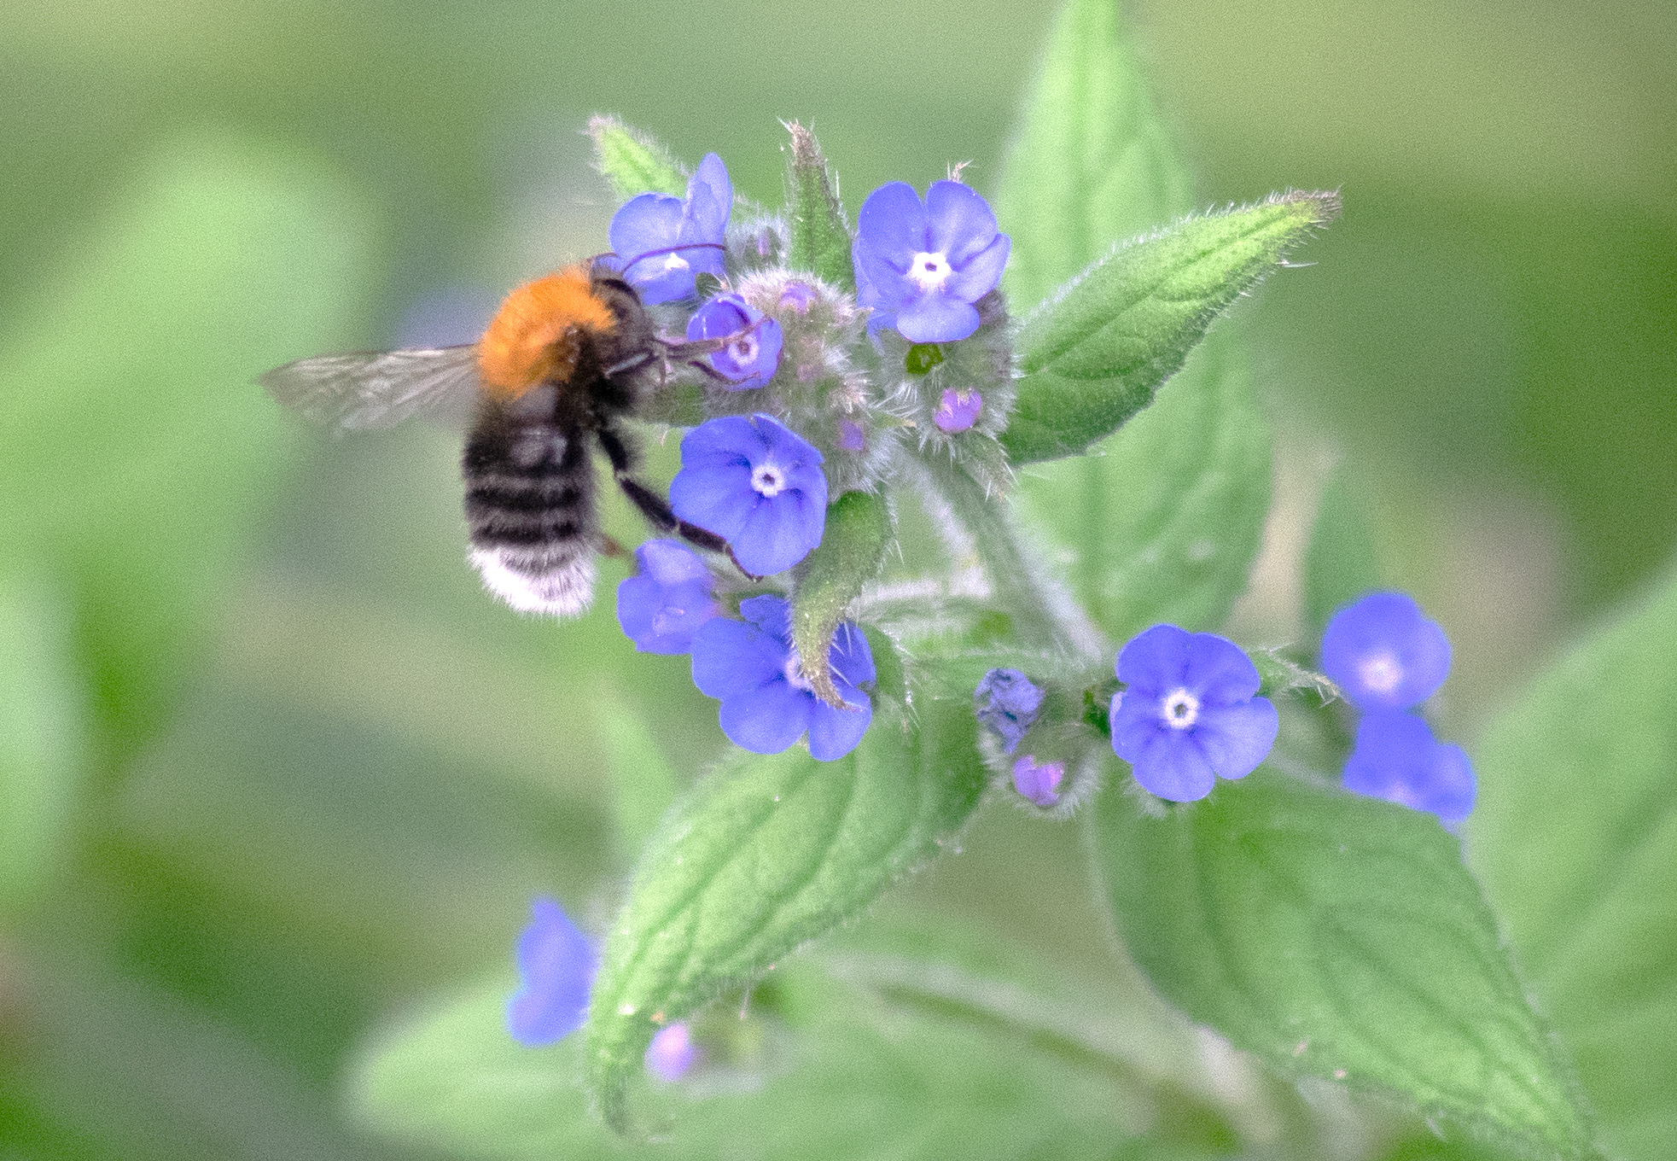
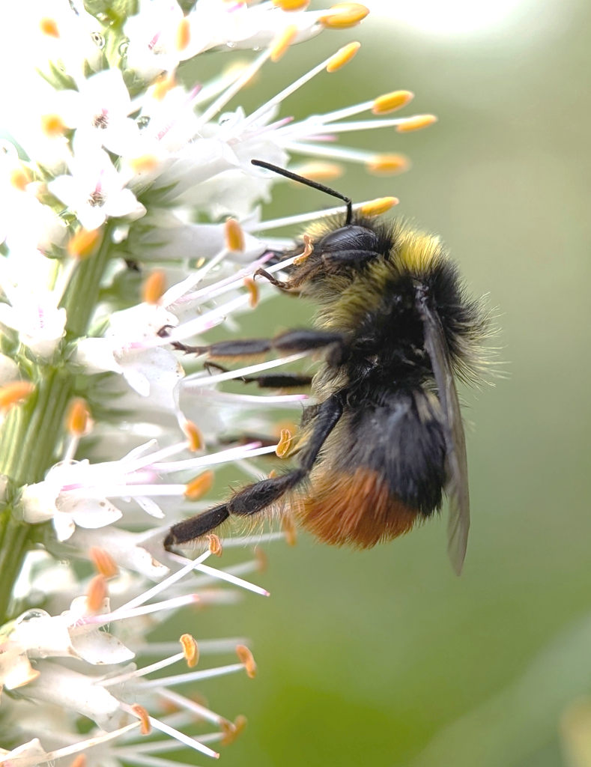
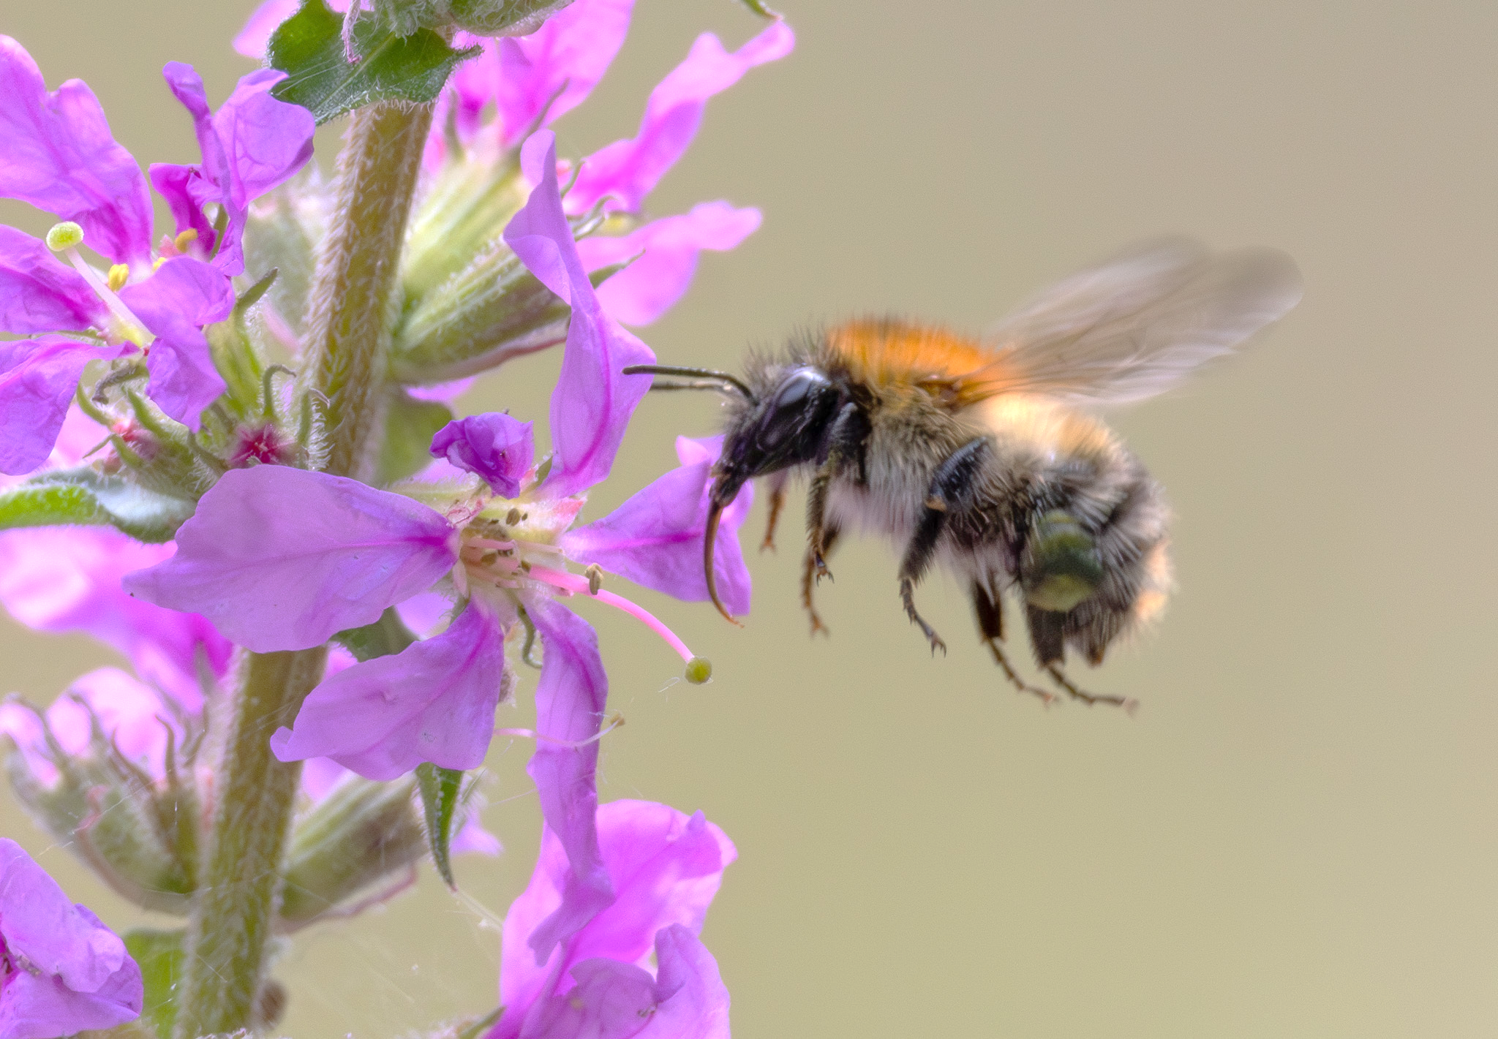
These are 3 different types of bumblebee.
What are some differences between them?
iNaturalist observation 171515975. CC0
iNaturalist observation 298704531. CC0
iNaturalist observation 302953806. CC0

Slide 17
Identifying bumblebees is a complicated problem because of the many differences between bumblebees.
Most problems can be broken down into simpler steps. This is called decomposition.
We need to decompose the problem of identifying bumblebees into simple steps.
iNaturalist observation 171515975. CC0
iNaturalist observation 298704531. CC0
iNaturalist observation 302953806. CC0

Slide 18
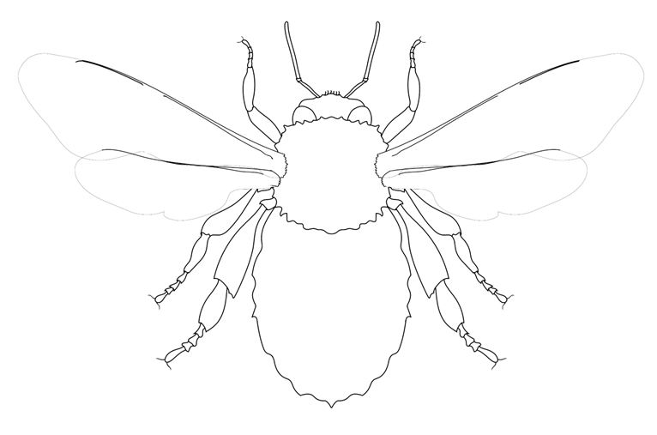
The bodies of bumblebees and other insects are divided into segments (parts).
We can decompose the problem of how to identify bumblebees by looking at the colours on different segments of their bodies.
Head
Thorax
Abdomen

Slide 19
Head
Computers can only follow very simple instructions.
Can we describe each body part with just one colour?
Thorax
Abdomen

Slide 20
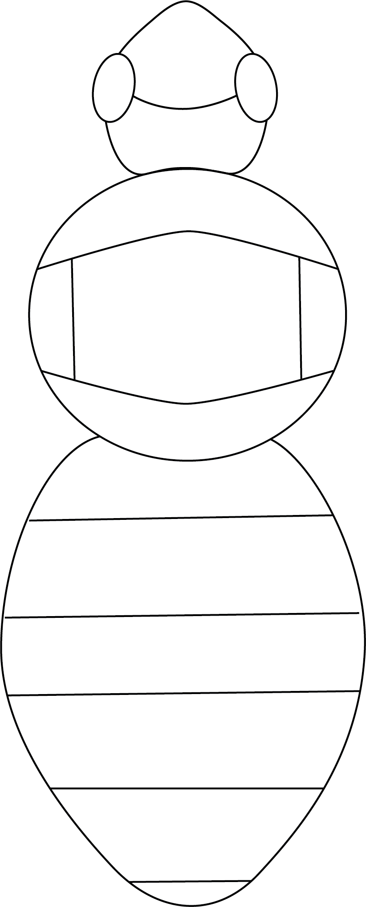
Detailed bumblebee decomposition
Face
Frons
Scutum
Scutellum
Propodeum
Pygidium
Entomologists (scientists who study insects) decompose bumblebees even further.
Here are some of the specific scientific terms for insect anatomy.
It can be difficult to see all those body parts in a photo because of all the fur.
Pleuron
Tergites 1-5

Slide 21
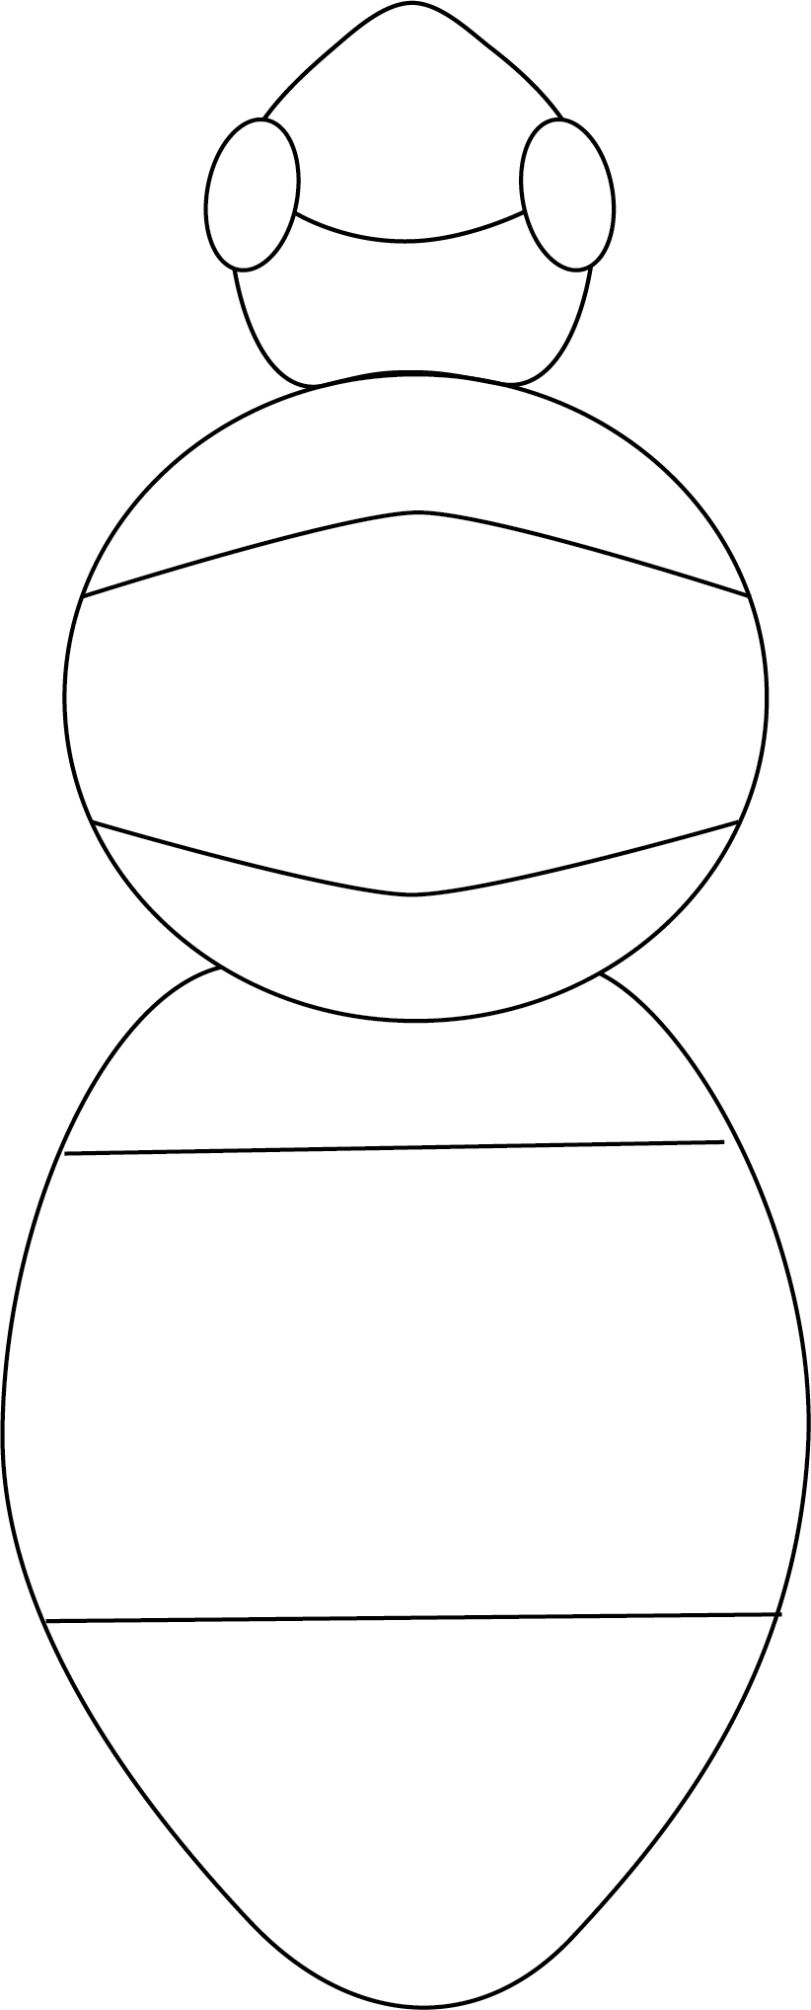
Face
Head
Collar
Back
Waist
Front of abdomen
Middle abdomen
Tail
Let’s group together the body parts that are difficult to see in a photo.
Is this still decomposed enough to capture the details in the photo?
Can we describe the colour of each body part with just one colour?

Slide 22
Face
Head
Collar
Back
Waist
Front of abdomen
Middle abdomen
Tail
The colour of each body part is a piece of information we will need to identify a bumblebee.
In computing we call information that can have different values variables.
Here we have decomposed bumblebees into 8 variables.
The value of each variable will be one colour.

Slide 23
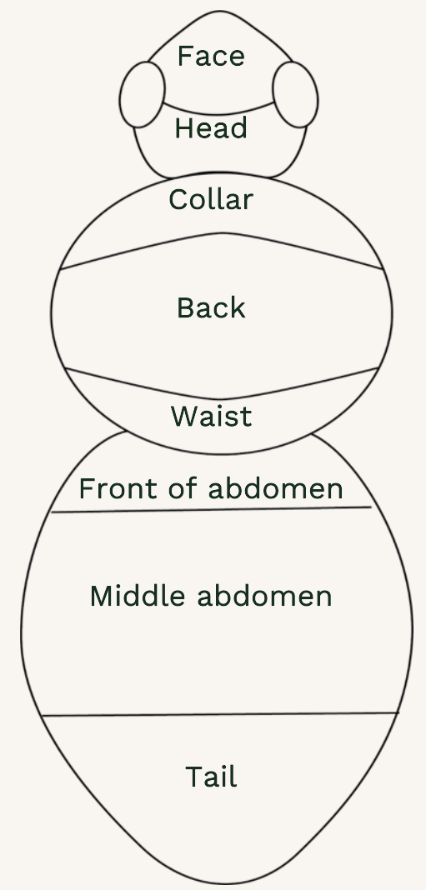
Each column in the table is a variable.
The contents of each spot in the table is the value of that variable, for that bumblebee.
Bumblebee number | Face | Head | Collar | Back | Waist | Front of abdomen | Middle of abdomen | Tail | Species
1

Slide 24
Look at the bumblebee cards and fill in the table with the colour of the body parts for each bumblebee.
Bumblebee number | Face | Head | Collar | Back | Waist | Front of abdomen | Middle of abdomen | Tail | Species
1
Notes:
The bumblebees on the cards are specimens from the collections at the Natural History Museum. The way that many insects are preserved in museums is by pinning them and letting them dry. Some of these specimens are more than 100 years old! Keeping a collection of insects like this gives us a historical record of bumblebees to help us see patterns and changes that take a long time to show up.

Slide 25
Reflection questions
What are the pros and cons of decomposing a problem into many smaller steps?
If we allowed more than one colour in each of our bumblebee variables, what extra challenges might that cause?

